Slide 1
Business Problem
In resent years , City hotel and Report hotel have seen high cancellation rates. Each
hotel is now dealing with a number of issues a result , including fewer revenues and
Less than ideal hotel room use. Consequently, lowering cancellation rates is both hotels’
Primary goal in order to increase their efficiency in generating revenue, and for us to
offer thorough business advice to address this problem.
The analysis of hotel booking cancellation as well as other factors that have no bearing
On their business and yearly revenue generation are the main topics of this report.
Assumptions
No unusual occurrences between 2015 and 2017 will have a substantial impact on the data used .
The information is still current and can be used to analyze a hotel’s possible plans in an efficient manner.
There are no unanticipated negative to the hotel employing any advised technique.
The hotels are not currently using any of the suggested solution.

Slide 2
5. The biggest factor affecting the effectiveness of earning income is booking cancellations.
6. Cancellation result in vacant rooms for the booked length of time.
7. Clients make hotel reservation the same year they make cancellations.
Research Question
What are the variables that affect hotel reservation cancellations ?
How can we make hotel reservation cancellations better ?
How will hotels be assisted in making pricing and promotional decisions ?
Hypothesis
More cancellations occur when prices are higher.
When there is a longer waiting list, customers tend to cancel mor frequently.
The majority of clients are coming from offline travel agents to make their reservations.

Slide 3
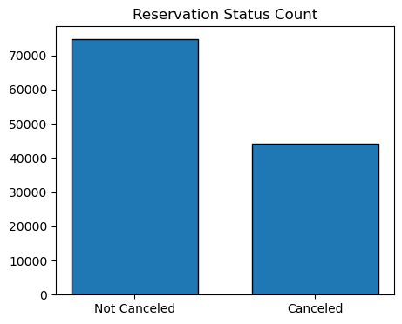
Analysis And Finding
This bar graph shows the percentage of reservation that are canceled and those that are not . It is obvious that are still a significant number of reservation that have not been canceled.
There are still 37% of clients who canceled their reservation , which has a significant impact on the hotels’ earnings.

Slide 4
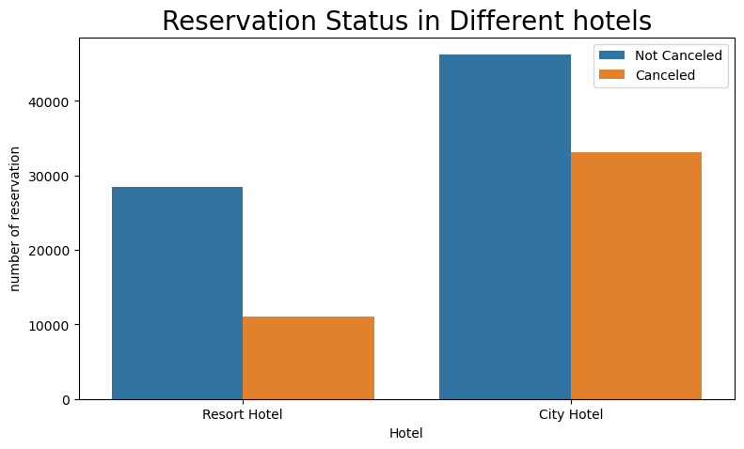
In comparison to resort hotels, city hotels have more bookings . It’s possible that resort
Hotels are more expensive than those in cities.

Slide 5
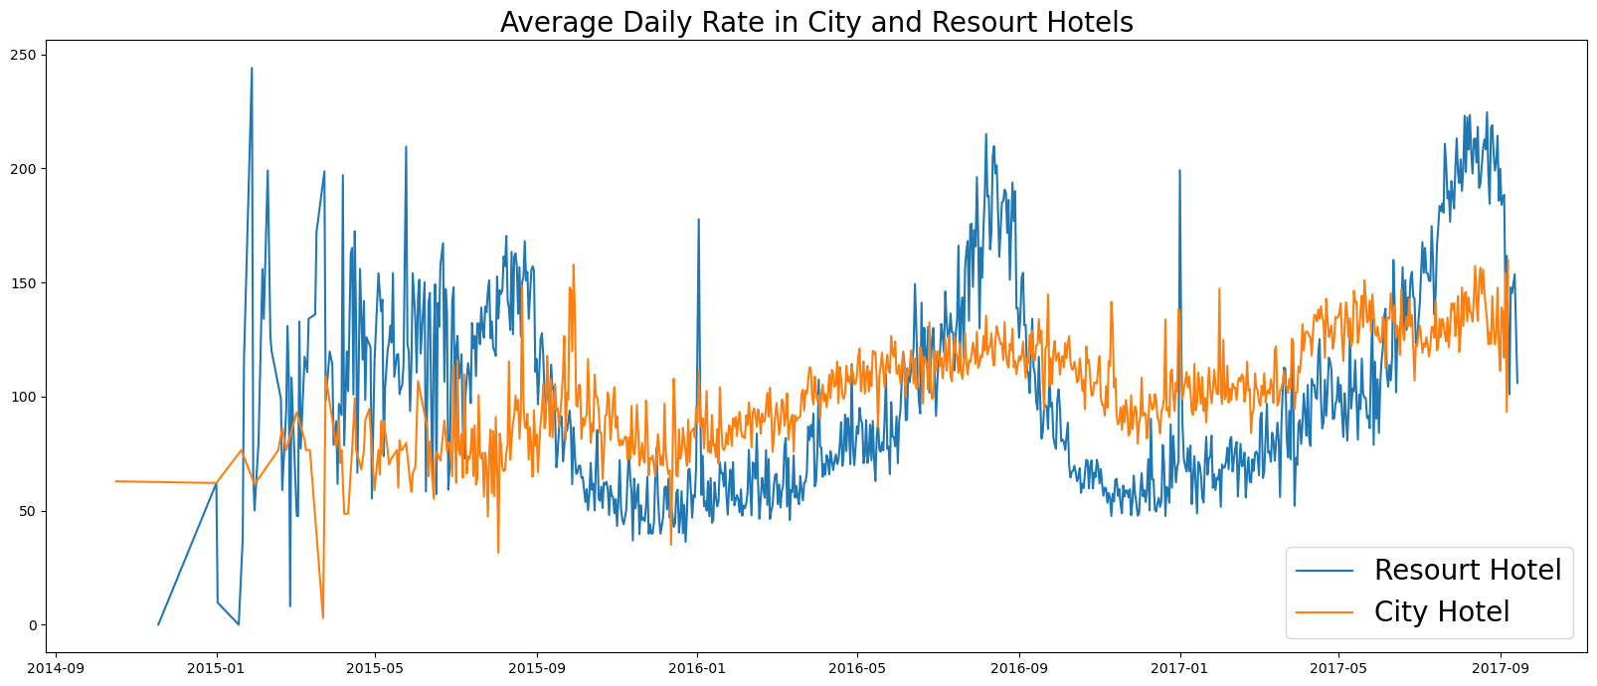
The line graph above shows that, on certain days, the average daily rate for city hotel is less than
of a resort hotel, and other days , it is a even less. It goes without saying that weekend and
Holidays may see is rise in resort hotel rates.

Slide 6
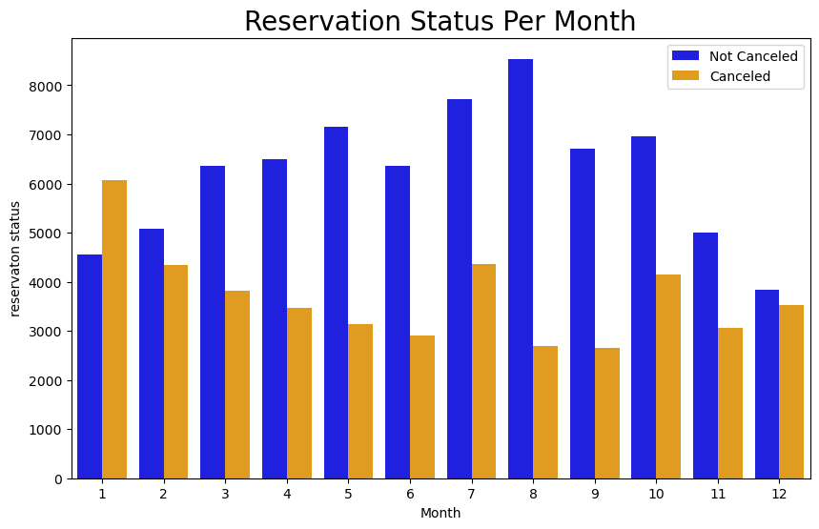
We have developed the grouped bar graph to analyze the month with the highest and lowest
reservation levels according to reservation status. As can be seen, both the number of
Confirmed reservations and the number of canceled reservations are largest in the month of
August . Whereas January is the month with the most canceled reservations.

Slide 7
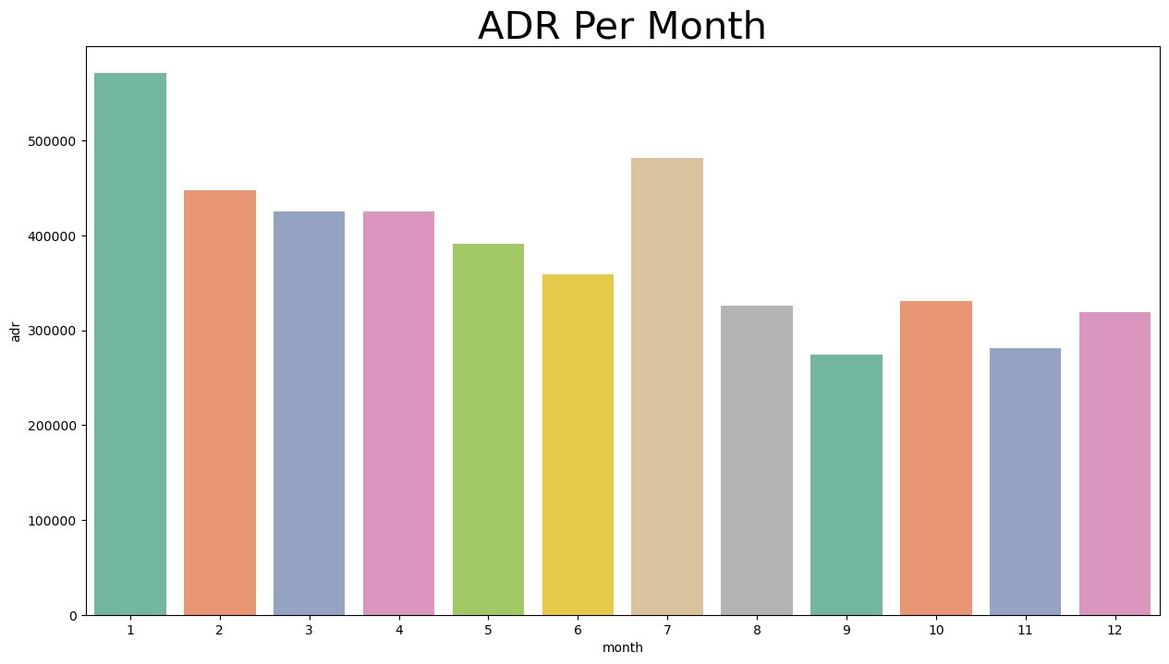
This bar graph demonstrates that cancellations are most common when price are greatest
and are least common when they are lowest. Therefore, the cost of the accommodation is
Solely responsible for the cancellation.
Now, let’s see which country has the highest reservation canceled. The top country is Portugal
With the highest number of cancellations.

Slide 8
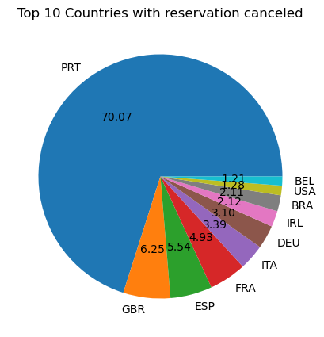
Let’s check the area where guests are visiting the hotels and making reservations.
Is it coming from direct or groups, Online or offline Travel Agents ? Around 46% of the
Client come from online travel agencies, Whereas 27% come from group. Only 4% of
clients book hotels directly by visiting them and making reservations.

Slide 9
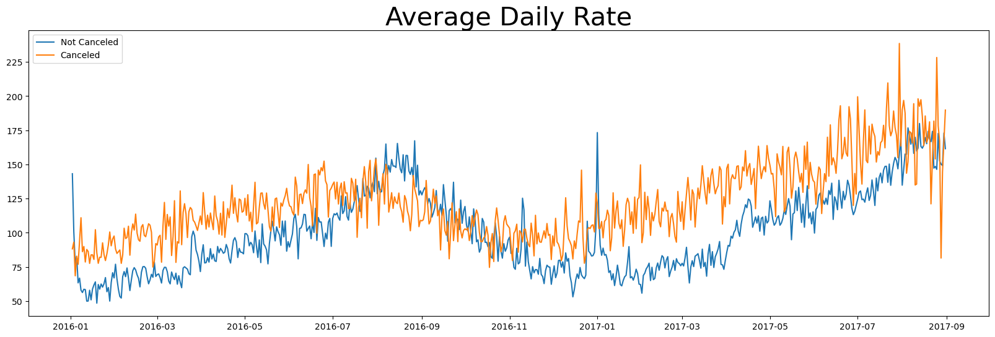
As seen in the graph, reservations are cancelled when the average daily rate is higher
Then when it is not cancelled. It clearly proves all the above analysis , that the higher
Price leads to higher cancellation.

